Slide 1
INDOOR 3D VISUALISATION & NAVIGATION
Members : Chenyue Li, Rinus, Tara, Sehan, Xinxhi

Slide 2
Overview
Goal
Data Acquisition & Modelling
Pathfinding
User Interface
Further steps

Slide 3
Goal
Create a 3D indoor model that aids first responders in visualising building interiors and plan out an effective route to victim locations.

Slide 4
Data Acquisition
Photogrammetry
Zebedee Lidar Scanner
Architectural Floor plan Extrusion

Slide 5
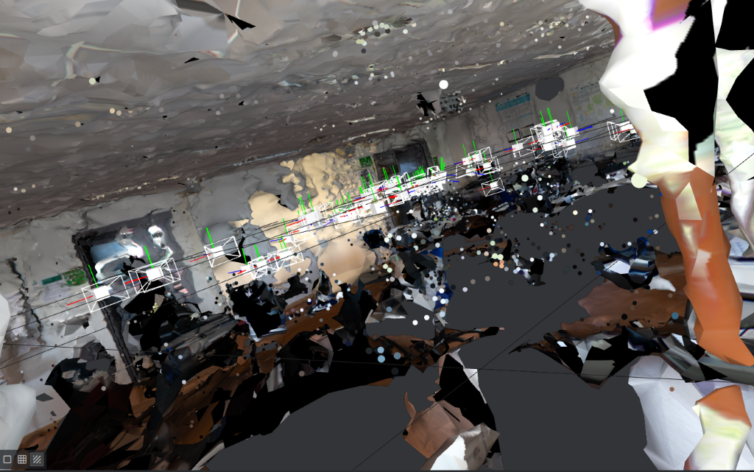
Photogrammetry
Distances and textures preserved
Time consuming
Took us 930 pictures for one room
Processing in MeshLab took over 2 days
Crashed multiple times

Slide 6
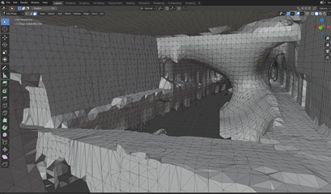
Zebedee Lidar Scan
Light and portable lidar scanner you can walk with
Took around 3 hours to acquire data for the Gaia building
Resulting mesh looked like a cave
Distance preserved

Slide 7
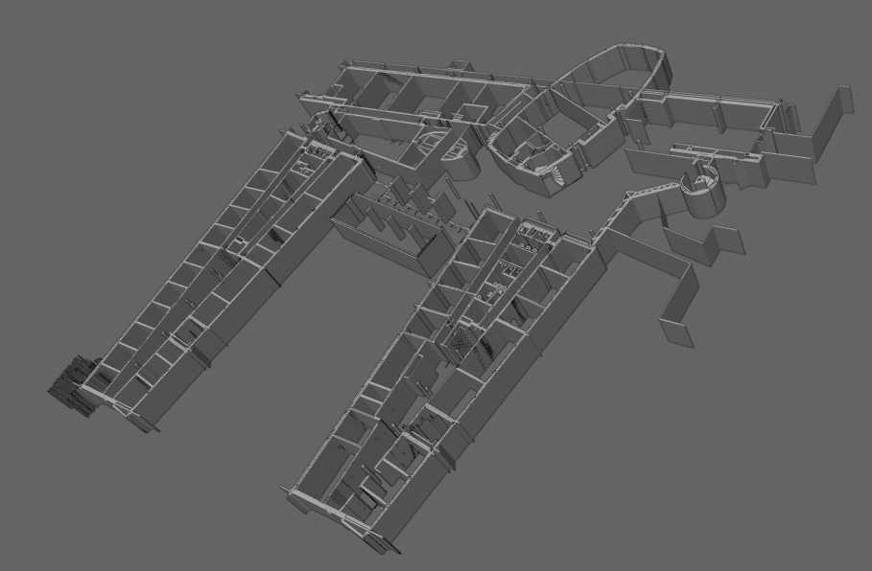
Floor Plan Extrusion
Data acquisition was minimal
Skipped straight to modelling
Took less than a day to model and pre-process two floors

Slide 8
Pathfinding
Grid Design
Algorithms

Slide 9
Grid Design
Waypoint system vs Grid-Node system
We went with a grid system
Use of Quad-Planes to create nodes
Placed in 3D

Slide 10
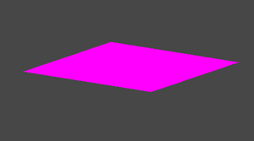
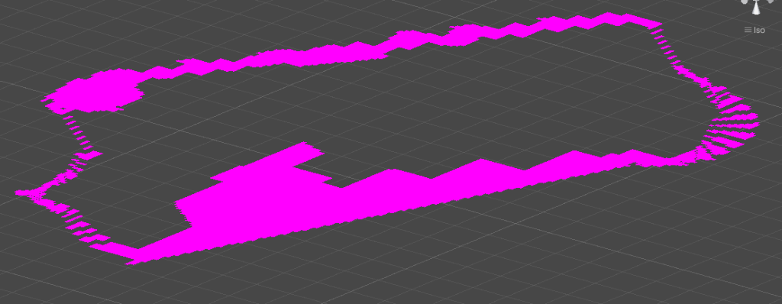
Quad Plane Node
Grid designed from nodes

Slide 11
Algorithms
Breadth First Search
Dijkstra
Greedy Best First Search
A-star

Slide 12
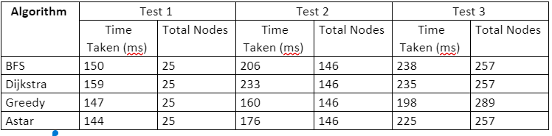
Algorithm Testing
Tests get progressively larger with Euclidean distance between start and and End node progressively increasing.

Slide 13
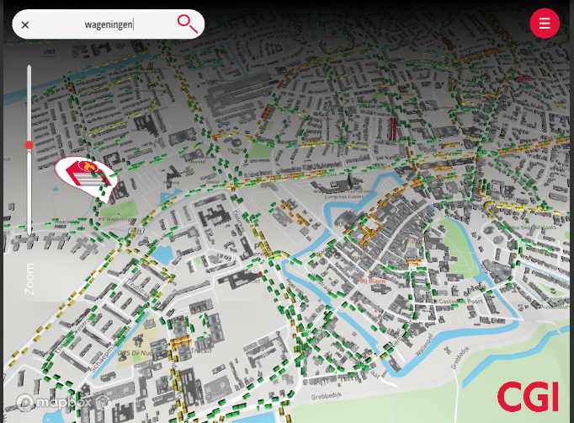
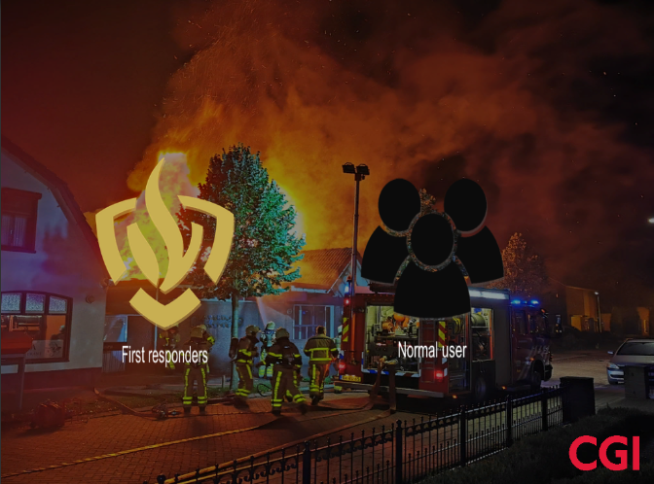
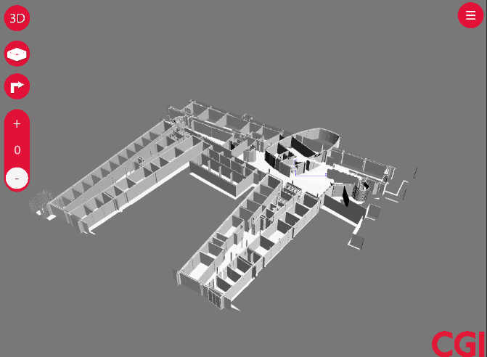
User Interface
Log In screen
City View Capability
3D model view
Multiple camera angles

Slide 14
Further Steps
Localisation
AR capability
HoloLens vs Zebedee Lidar Scanner
Unreal Engine vs Unity Engine

